Slide 1
Information Retrieval
Assignment 2: TF-IDF
Presented by: M. Umair Shahid [2021-CS-144]
Instructor: Dr. Khaldoon Syed Khurshid
Department of Computer Science University of Engineering and Technology Lahore

Slide 2

Agenda
1.
Introduction
2.
Goal Definition
3.
Document Collection
4.
Implementation Plan
5.
Approaches
6.
Backend
7.
User Interface
8.
Shortcomings

Slide 3
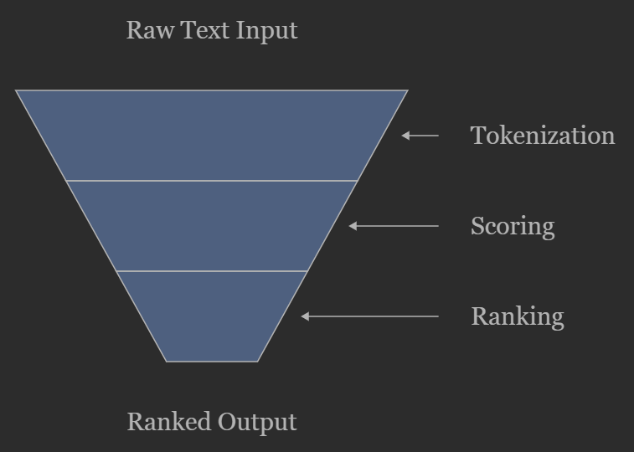
Introduction
Building a Document Search Engine with Scoring
The system focuses on preprocessing, tokenization, and ranking.
Extracts nouns related to technology using heuristics.
Implements TF, IDF, TF-IDF, and Cosine Similarity for ranking.

Slide 4
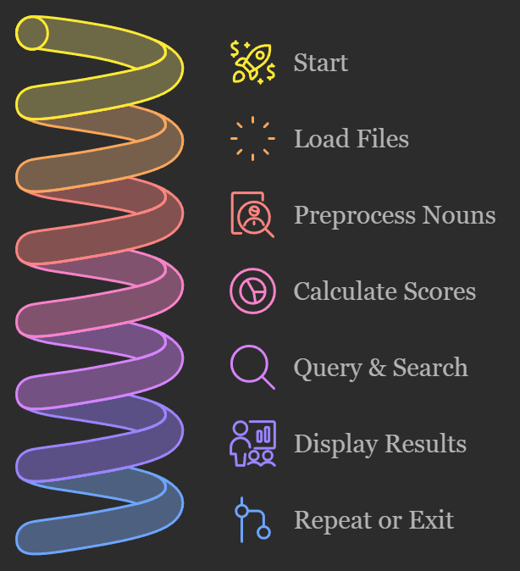
Goal Definition
Optimize document ranking using advanced techniques (TF-IDF, Cosine Similarity).
Enable customizable folder paths for real-time updates.
Ensure accurate noun extraction using heuristics.

Slide 5

Document Collection
Input: .txt files from a specified folder path.
Preprocessing:
Convert to lowercase.
Extract nouns using a heuristic function optimized for terms.
Example of extracted terms: "automation, robotics, AI, ethics".

Slide 6
Approaches
Heuristic Noun Extraction: Filters trivial words; focuses on domain-specific terms.
Scoring Algorithms:
TF: Frequency of a term in a document.
IDF: Penalizes terms common across many documents.
TF-IDF: Combines TF and IDF
Cosine Similarity: Measures query-document vector similarity.

Slide 7
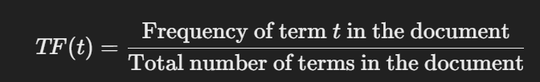
TF
What it is: Measures how often a term appears in a document.
Formula:
Example:
If a term appears 50 times in a document with 100 total words:
TF= 50/100​ = 0.2

Slide 8

IDF
What it is: Measures how unique a term is across documents.
Formula:
N = is the total number of documents in the collection.
n = is the number of documents that contain the term you’re interested in.
Why Log:
Normalize and balance scores: Ensures term importance is scaled effectively and prevents division by zero.
Enhances interpretation: Provides an intuitive measure of a term's rarity or significance in the document collection.
Example:
If the term appears in 2 out of 12 documents:
IDF = log (12 \ 2+1) = log(4) = 0.345

Slide 9
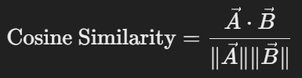
Cosine Similarity
What it is: Measures similarity between two documents by comparing angles between their term vectors
Formula:
Document Vector Creation(Local (document-specific)):
Represents the local importance of search terms within a specific document.
Calculated using TF-IDF scores, highlighting the term's relevance to that document.
Query Vector(Global (across the entire collection)):
Represents the global significance of search terms across all documents.
Acts as a reference point to measure similarity between the query and documents

Slide 10
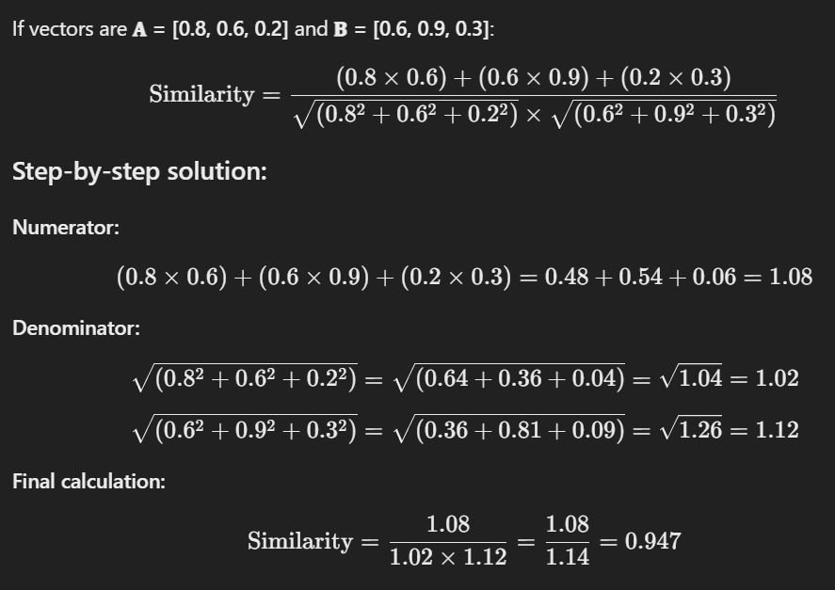
Cosine Similarity (cont.)
Example:

Slide 11

Backend
Modules:
tokenize_nouns(): Extracts meaningful terms.
calculate_tf() and calculate_idf(): Computes scores.
calculate_cosine_similarity(): Implements vector similarity.

Slide 12
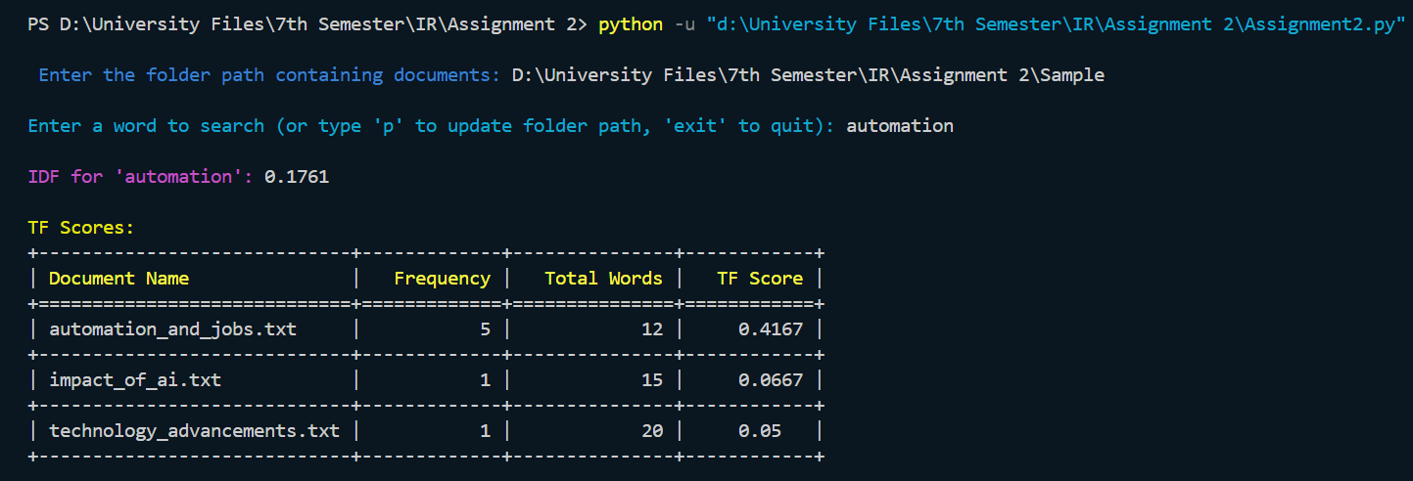
User Interface
Colorama: CLI enhancements to provide better User Interface.

Slide 13

Shortcoming
Static Noun Extraction: Heuristic-based extraction may miss context-specific nouns.
Duplicate Tokens: Repeated terms in preprocessing inflate results.
Limited Query Options: No support for multi-word or phrase searches.
Exact Match Dependence: Lacks support for stemming or semantic variations.
Basic Cosine Similarity: Relies on raw term vectors, missing advanced embeddings.

Slide 14
Thank You
Suggestions and Questions are welcomed!

